Slide 1
Introduction to SQL Database
CODE YOUR FUTURE

Slide 2
Let’s Build an Online Music Store System
Requirements
Store Albums , Artists , Tracks , Purchases data
Find Transaction information information by album , artist, inovices, sales agents
Browse most popular tracks by artist
All customers who bought a certain artist production
Most/Least Popular albums

Slide 3
Let’s Design Our Music MGMT System
Variable are memory ..memory is volatile.
Ok .. Let’s use the hard disk!
We will write things in a file..
Read the file .. Parse its contents.. Display it!
Our start-up succeeded .. We have million entries now !
Accident .. Our hard disk crashed

Slide 4
Describe a good storage system
Searching time
Storing time
Scalable
Integrity
Consistent
Reliable

Slide 5
Data .. About Data
Data ..
needs a type : number/date/string
is understood through a context ..
Tell me your “number” ( of items sold ? Items returned ? )
Has constraints
Size, unique , Mandatory , Range of values ..
Has relationships
Schema
Artist Name | Album date | Album Title | Artist
Ali | 09/05/2016 | Balls to the Wall | Accept
Mark | 01/12/2016 | Restless and Wild | Aerosmith

Slide 6
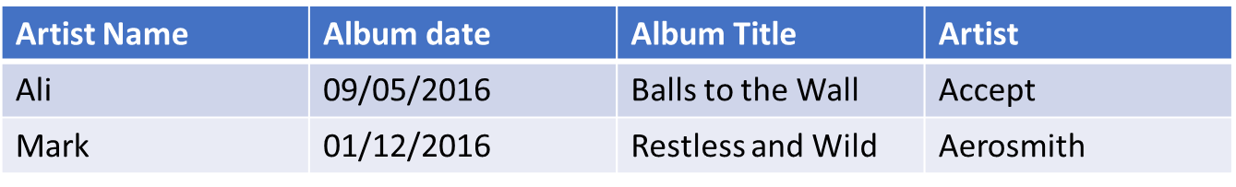
Fields.. Rows .. Columns.. Tables!

Slide 7
Add Students with Departments
Name | Date of Birth | Telephone | Postcode | Department Name | Dean | Dean Teleph
Ali | 09/05/1980 | 0204545454 | E1Y 2CF | Engineering | Prof. John | 02023454
Mark | 01/12/1979 | 0212154545 | SW5 12M | Engineering | Prof. John | 02023454
Sarah | 05/11/1985 | 0215454658 | N1 2FE | Medicine | Prof. Alex | 545445454
Ahmed | 05/15/1984 | 0215446656 | SW1 1ML | Engineering | Pro. John | 02023454
Repetition .. Redundancy
Disk/Memory Size
Relevance?
Prof. John .. Changed his phone number.. Enjoy updating!

Slide 8
Field .. Row .. Table .. ?!
Track
Artist
Invoice
User
Playlist
Purchase
Album
Is one table enough ?
Data Normalization
Entity ( almost .. Table)

Slide 9
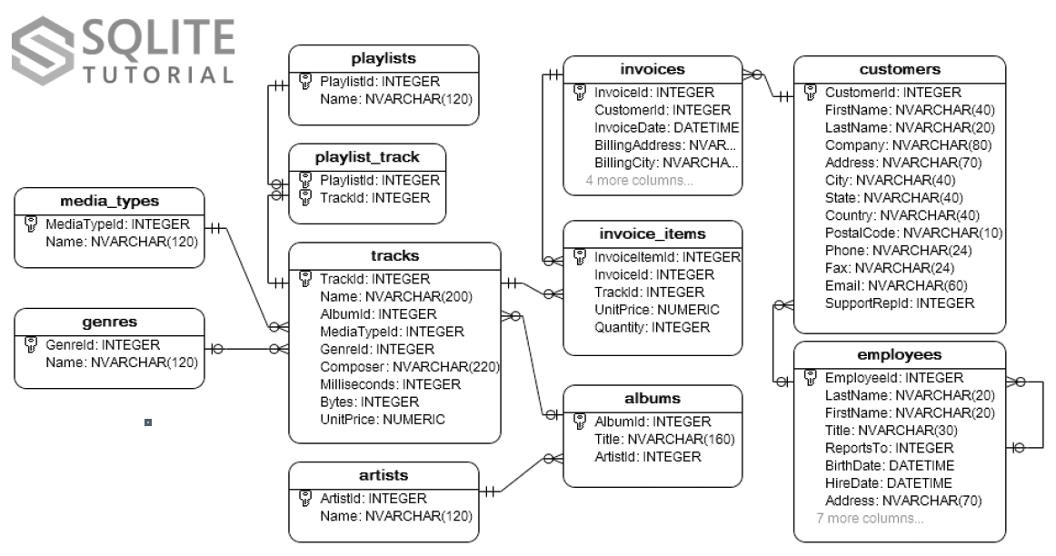

Slide 10
Relationship Types
Explore relationships in our Music System
Album to track ?
Artist to Track?
Invoice to track
Invoice to customer
Album to genre
How relationships are stored
Primary Key , Foreign Key
Indexing

Slide 11
Database Management System/ DB Server
Out of the Box System
Many vendors , same concepts
We don’t write DBMS .. We install it
A DBMS Server Hosts Multiple Databases
Databases are created Empty
We Configure the database to Host a “Schema” Using DDL
We Insert , Query , Update, Delete Data using SQL
We write mini-programs “Stored Procedures” using PL-SQL

Slide 12
A good DBMS will..
Implements ACID
Atomic , Consistent , Isolation, Durable
Support SQL
Scalability Arrangements
Availability & Fault tolerance
Caching
Transaction Handling , roll back , commit
Back up and restore
Auditing & logging
Security

Slide 13
SELECT Statement
What
Sort
Columns
Function
All
From
Table
Multiple Tables
Filter
Equality
Similarity
Boolean Expression
Ascending
Descending

Slide 14
Selecting from Multiple tables
Cross Join
Inner Join
Outer Join
Handling Similar Column Names

Slide 15
SELECT Statement
Select columns
Order of columns in select
Select (*)
Applying function to columns ( Upper )

Slide 16
Writing a filter
Where clause
Single condition
Using Functions in conditions
Like
AND
OR
Refresh on Boolean algebra

